Slide 1
S
SENTAKU TRADING — FZCO
Sentaku Trading.
From concept to creation, seamlessly delivered.
COMPANY PROFILE
DUBAI · DHAKA
MMXXVI
EST. 2026
HQ DUBAI, UAE
PRODUCTION BANGLADESH
MARKETS NA · EU

Slide 2
Sentaku Trading
02 — COMPANY
At a glance.
COMPANY
Sentaku Trading FZCO
ESTABLISHED
2026
HEADQUARTERS
Dubai, United Arab Emirates
The essentials — who we are, where we’re based, and how to reach us.
SOURCING BASE
Dhaka, Bangladesh
WEBSITE
sentakutrading.com
CONTACT
afnan@naturalgroup.org · +880 130 1114444

Slide 3
Sentaku Trading
03 — ABOUT
Fashion,
sourced with intention.
Sentaku Trading is a dynamic apparel trading and sourcing company connecting global fashion markets with Bangladesh’s world-class manufacturing. We procure orders from North America and Europe, executing seamlessly from concept to final delivery.
Beyond traditional sourcing, we offer comprehensive design and development, transforming ideas into commercially viable products. Our expertise in washing R&D ensures every garment meets the trends, finishes, and quality standards demanded internationally.
Sentaku — Japanese for selection — is our promise: every factory, every fabric, every finish chosen with care.
From fabric sourcing and sampling to production coordination and QA, we offer end-to-end support — built on reliability, transparency, and efficiency.

Slide 4
Sentaku Trading
04 — PRINCIPLES
MISSION
01
VISION
02
“
“
To deliver high-quality, innovative apparel solutions by seamlessly connecting global brands with Bangladesh’s manufacturing excellence — through reliable sourcing, expert development, and efficient execution.
To become a globally trusted apparel trading partner , recognized for innovation, speed, and quality — bridging international fashion markets with responsible, world-class production in Bangladesh.

Slide 5
Sentaku Trading
05 — VALUES
Four commitments.
The principles that guide every order, sample, and partnership we take on.
01
02
03
04
Integrity & Transparency
Quality First
Innovation & Development
Strong Partnerships
Honest communication with clients and partners. From costing to production timelines, we ensure clarity at every stage.
Quality is at the heart of everything we do. Every product meets international standards and buyer expectations.
Strong design support and washing R&D, continuously bringing new ideas, trends, and finishes to the market.
We grow together. Relationships with factories, suppliers, and clients built on mutual respect and shared success.

Slide 6
Sentaku Trading
06 — SERVICES
End-to-end, from brief to box.
/01
Sourcing & Procurement
Matching each order to the right factory from our vetted partner network.
/02
Design & Development
From mood boards to fit-approved samples — commercially viable from day one.
Five integrated services, one point of contact — so brands can focus on selling while we handle the making.
/03
Washing R&D
Specialist denim finishes, hand-feel, and sustainable washes at trend-setting standards.
/04
Production Coordination
Critical path management across fabric, trim, bulk, and shipment.
/05
Quality Assurance
In-line and final inspections against buyer-spec AQL before every ship-out.

Slide 7
Sentaku Trading
07 — PROCESS
Concept to carton.
A transparent six-stage process. Every step has a single owner, a clear milestone, and a documented hand-off.
01
02
03
04
05
06
Brief & Intent
Sourcing Match
Development
PP Sample & PO
Production & QA
Ship & Deliver
Aesthetic direction, price point, target markets, MOQ & lead-time expectations.
Factory selection; fabric and trim sourcing; costing and feasibility.
Tech-pack, proto, fit and wash samples. Rounds until approval.
Pre-production sample sign-off; bulk fabric in; PO confirmed.
Cut, sew, wash, finish — inline and final AQL inspections.
Export docs, logistics coordination, on-time delivery to DC.
WEEK 00 · BRIEF RECEIVED
TYPICAL LEAD TIME — 90 TO 120 DAYS
WEEK ~14 · CARTONS ON WATER

Slide 8
Sentaku Trading
08 — CATEGORIES
Product categories.
From heritage denim to refined knits — with washing and finishing expertise across every category.
/01
/02
/03
/04
Denim
Wovens
Knits
Outerwear
Jeans, jackets, skirts — specialist washes
Shirts, bottoms, dresses & separates
Tees, fleece, heavyweights, sweats
Jackets, coats, utility & workwear

Slide 9
Sentaku Trading
09 — MANUFACTURING
Why Bangladesh.
#2
200+
GLOBAL APPAREL EXPORTER
LEED GREEN FACTORIES
Second only to China in ready-made garments worldwide.
More certified green factories than any other country.
MOQ — SAMPLING
30 pcs / style
40+
$47B
500 — 1,000 pcs / style
MOQ — BULK
YEARS OF CRAFT
ANNUAL RMG EXPORTS
LEAD TIME — DEV
3 — 4 weeks
A mature, deeply-specialized garment ecosystem.
Scale, capacity, and proven delivery to global brands.
LEAD TIME — BULK
60 — 90 days
COMPLIANCE
BSCI · Sedex · WRAP

Slide 10
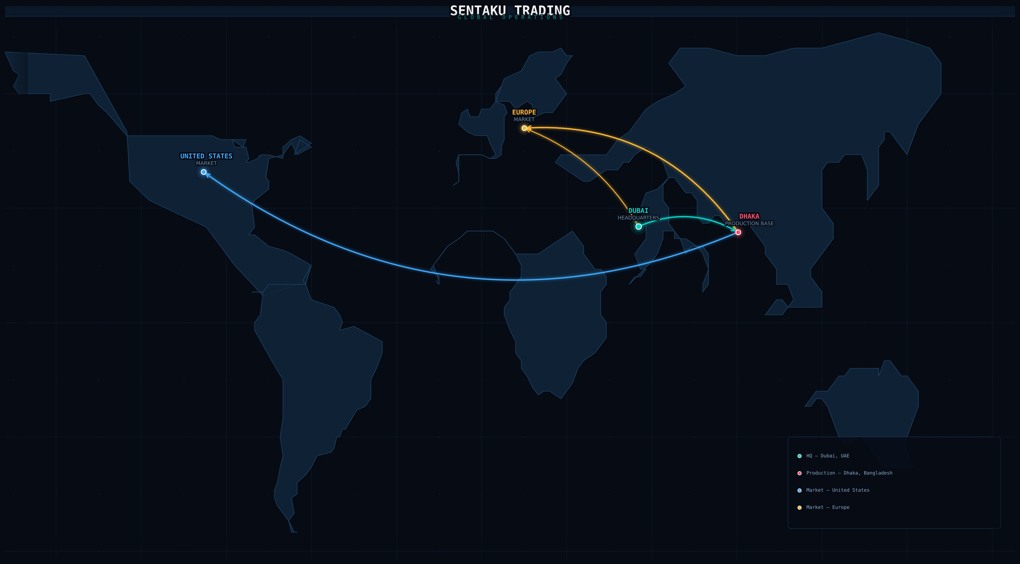
Sentaku Trading
10 — FOOTPRINT
A bridge between markets and making.
/ 01 — HEADQUARTERS
Dubai, UAE
FZCO
/ 02 — PRODUCTION
Dhaka & Chattogram
BD
/ 03 — MARKETS SERVED
United States
NA
Canada
NA
United Kingdom
EU
Germany · France
EU
Italy · Spain
EU
Netherlands · Nordics
EU

Slide 11
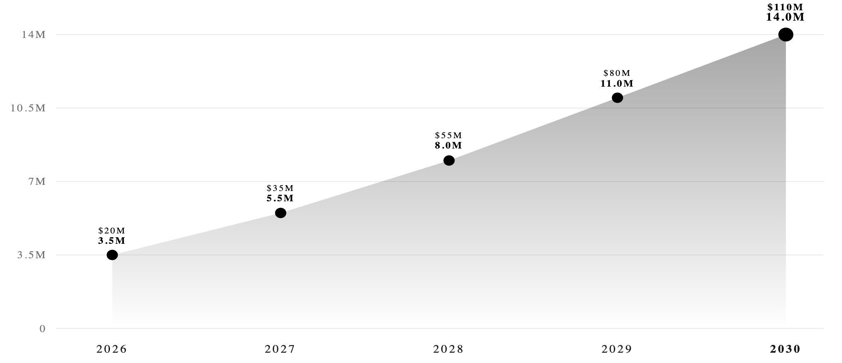
Sentaku Trading
11 — OUTLOOK
Managing exports globally.
A five-year trajectory — from our first production year through projected growth across North America, Europe, and new markets.
UNITS SHIPPED (MILLIONS) · EXPORT VALUE (USD)
2026 → 2030 FORECAST
MILESTONES & MARKET EXPANSION
2026
Foundation · $20M
3.5M units · 2 anchor brands · NA pilot
2027
EU entry · $35M
5.5M units · UK + DE lanes · 5 partners
2028
Scale & sustainability · $55M
8.0M units · LEED-only · in-house wash R&D
2029
Japan & APAC · $80M
11.0M units · Tokyo rep · designer-label prog.
2030
Global reach · $110M
14.0M units · 20+ brands · 15 countries

Slide 12
Sentaku Trading
12 — PARTNERS
Key clients & partners.
Brands we’re proud to have produced with — across premium denim, contemporary and designer apparel.
/01
/02
/03
/04
/05
Centric Brands
Buffalo
Hudson Jeans
Joe’s Jeans
Off — White
PORTFOLIO · US
DENIM · CA
DENIM · US
DENIM · US
DESIGNER · IT
LICENSED APPAREL
PREMIUM DENIM
CONTEMPORARY
PREMIUM DENIM
LUXURY STREETWEAR
Shown as text placeholders — we can swap in approved logo lockups for the final presentation.

Slide 13
Sentaku Trading
13 — CONTACT
Let’s make something.
GET IN TOUCH
COMPANY
Sentaku Trading — FZCO
EMAIL
afnan@naturalgroup.org
PHONE
+880 130 111 4444
WEBSITE
sentakutrading.com
Share a brief, a reference, a tech-pack — or just a question. We’ll come back within one business day.
HEADQUARTERS
Dubai, United Arab Emirates
START A CONVERSATION
→

